Slide 1
Term 1 & Term 2: Data Analysis with Python & EDA - (26th July'20)
Sayed Sajjad
Objective: The idea of a project is to combine all the concepts learned in class and check how to apply them in the real world. I have used various visualization techniques to draw insights from data and perform EDA on the dataset to get detailed insights about the data.

Slide 2
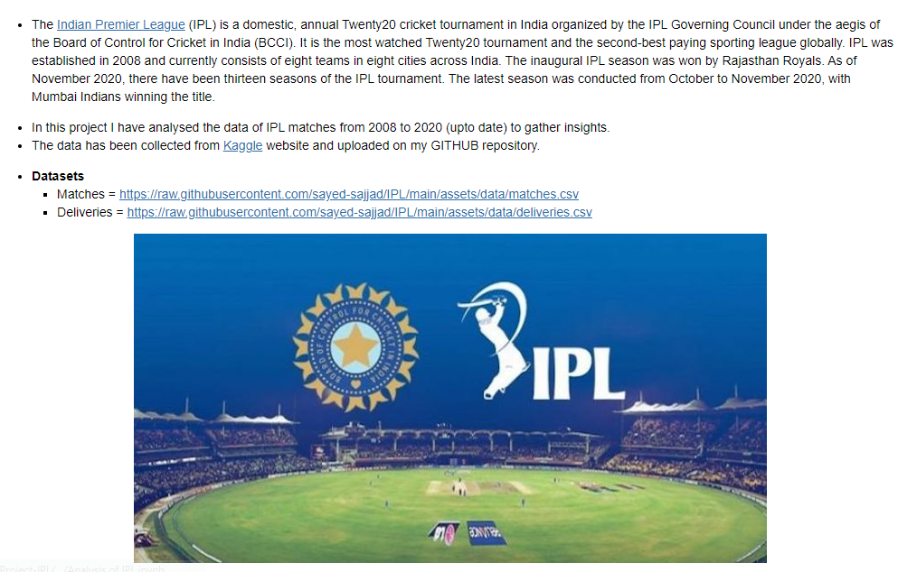
Introduction

Slide 3
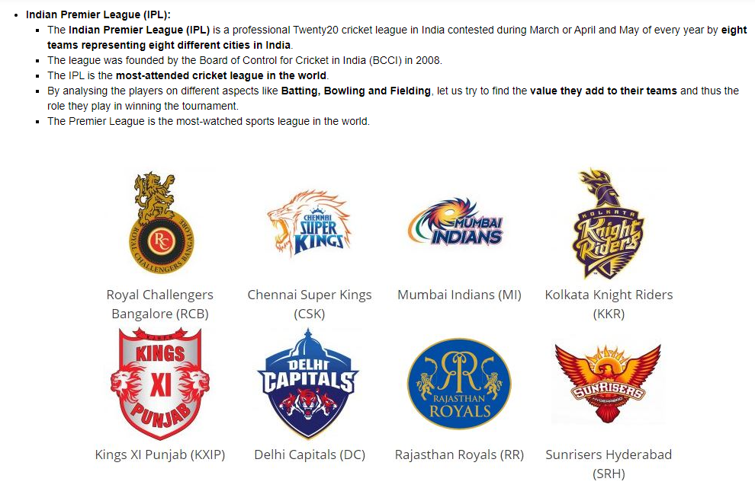
Problem Statement

Slide 4
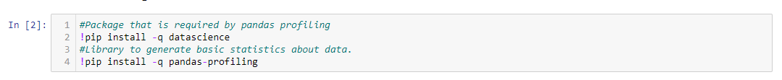
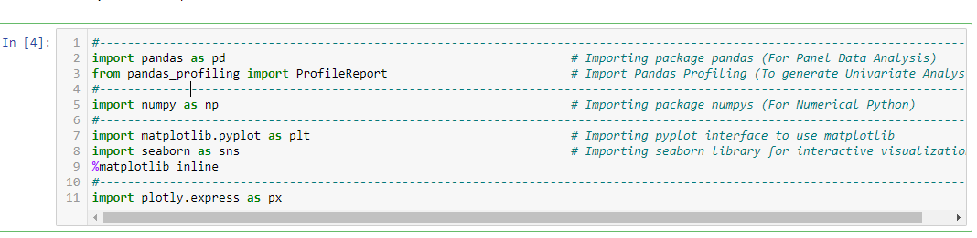
Installing, Upgrading and Importing Libraries

Slide 5
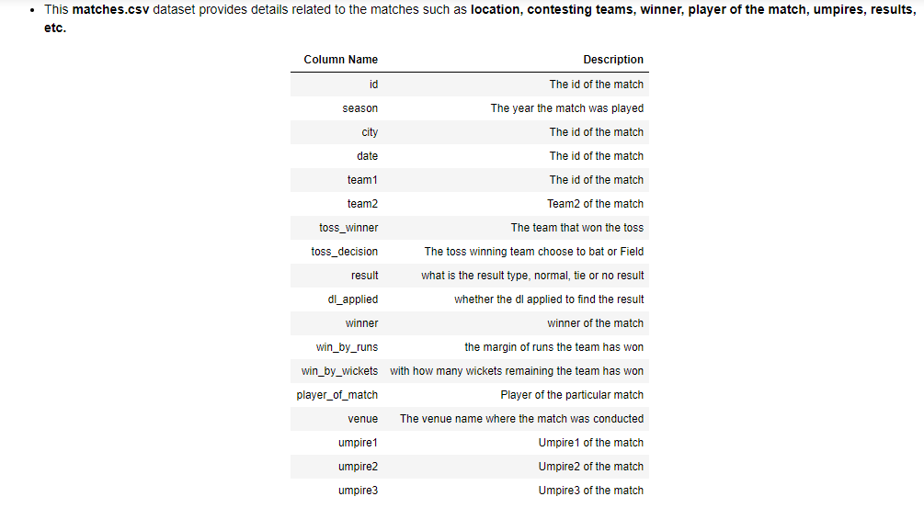
Data Acquisition & Description – matches.csv

Slide 6
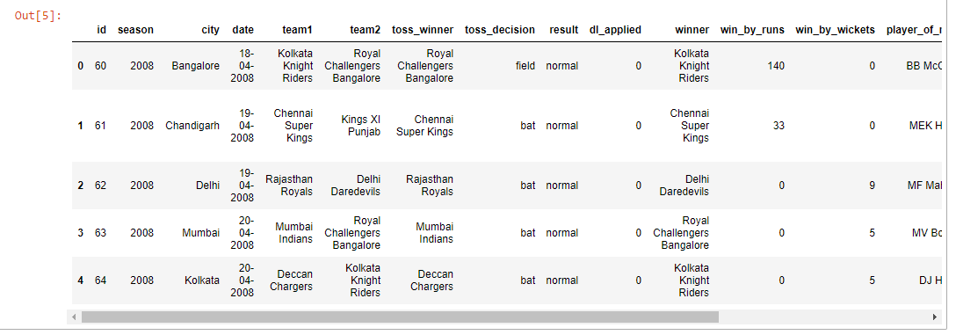
Data Acquisition & Description – matches.csv

Slide 7
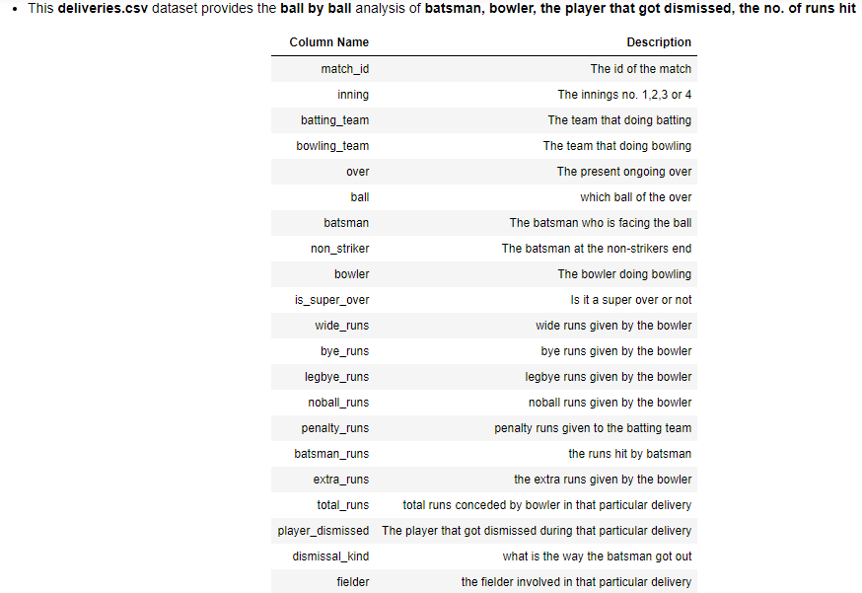
Data Acquisition & Description – deliveries.csv

Slide 8
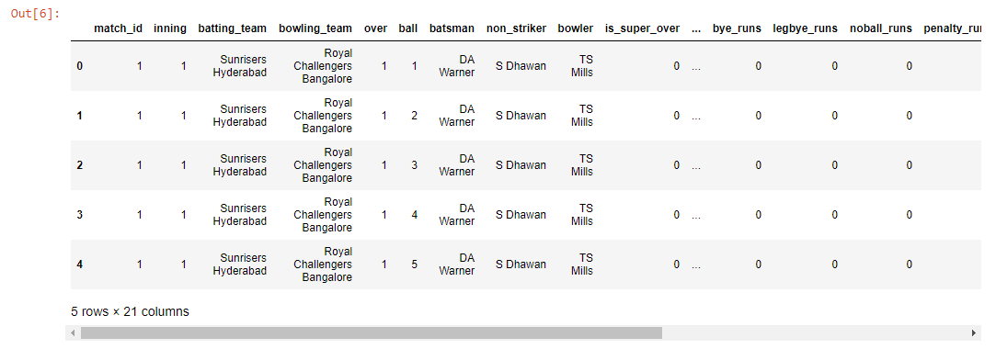
Data Acquisition & Description – deliveries.csv

Slide 9
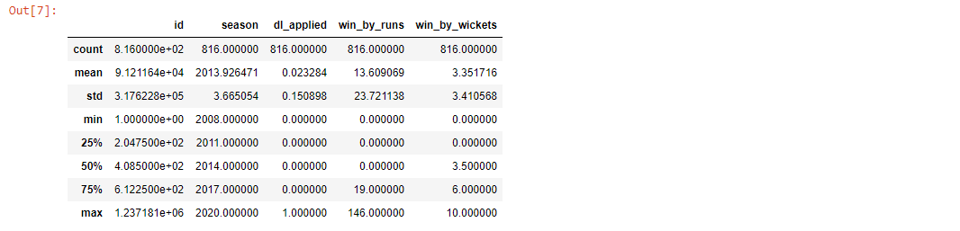
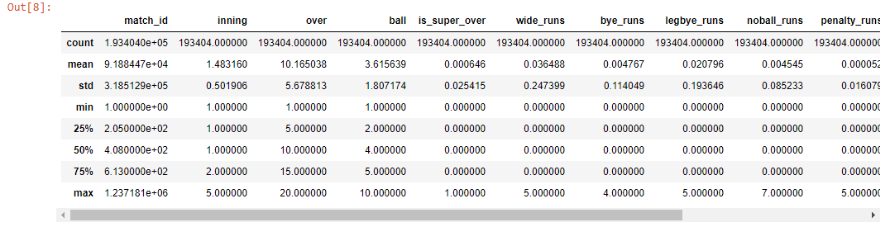
Data Acquisition & Description – Describe

Slide 10
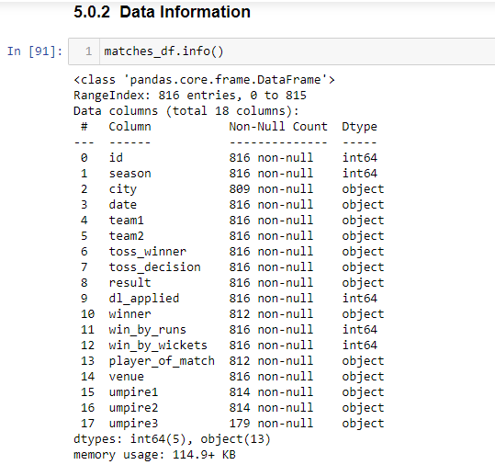
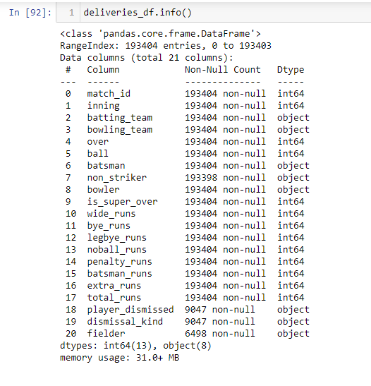
Data Information – matches & deliveries

Slide 11
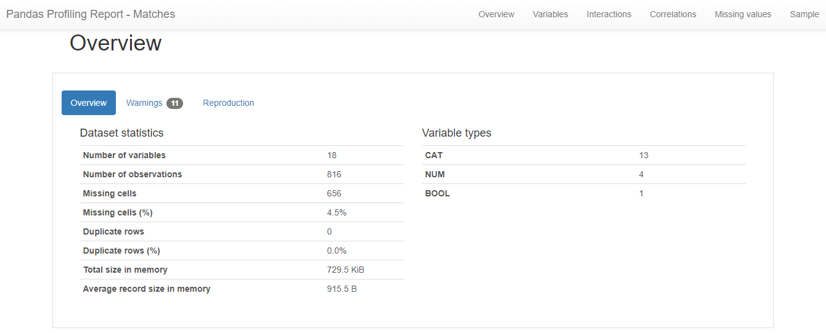
Pandas Profiling - Matches

Slide 12
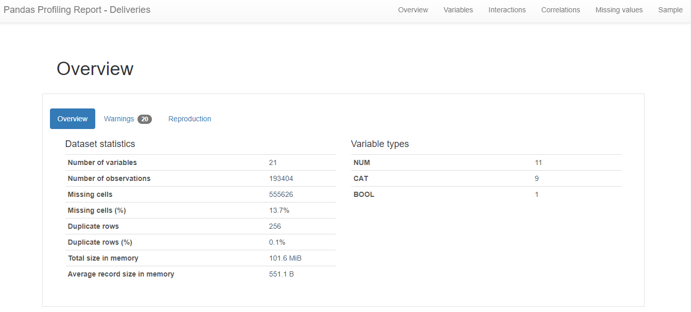
Pandas Profiling - Deliveries

Slide 13
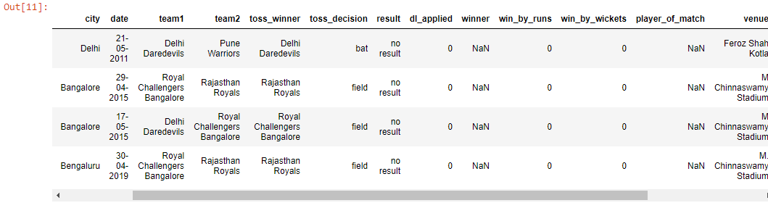
Data Pre-Processing – Handling missing data

Slide 14
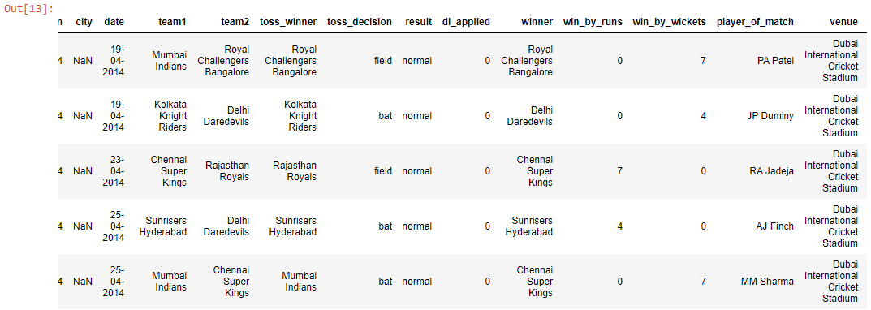
Data Pre-Processing – Handling missing data

Slide 15
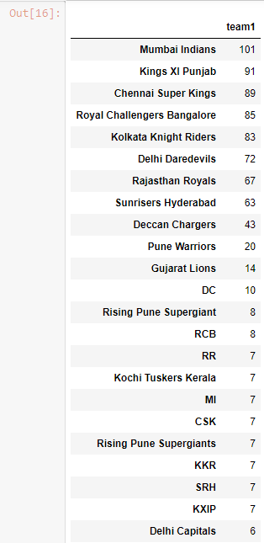
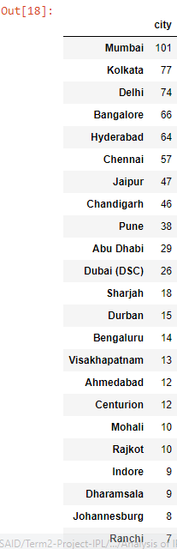
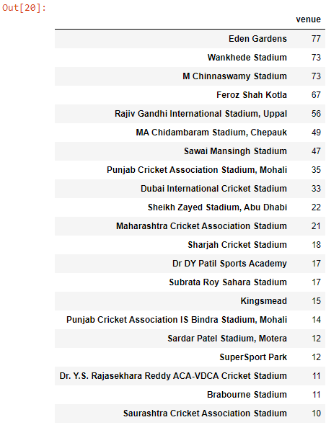
Data Pre-Processing – Handling inconsistent data, outliers and typo errors.

Slide 16
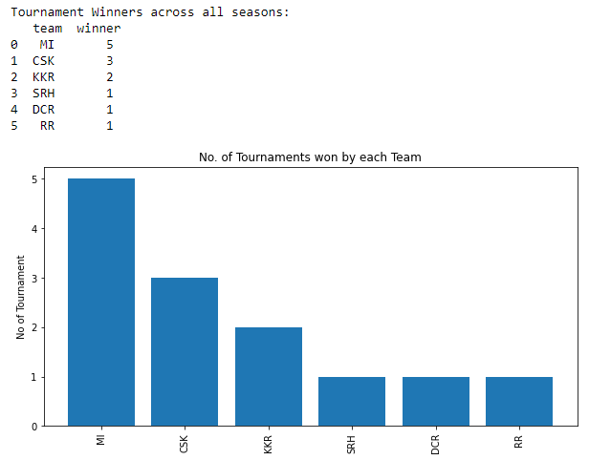
EDA -Winners across all Seasons (By Matches)

Slide 17
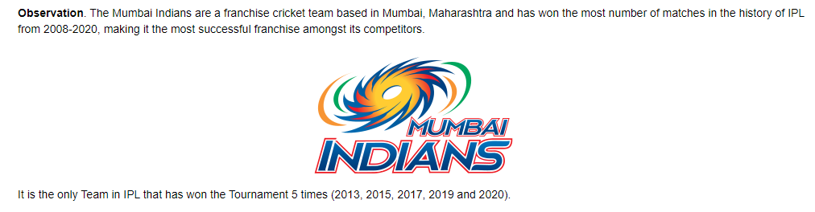
EDA -Winners across all Seasons (By Matches)

Slide 18
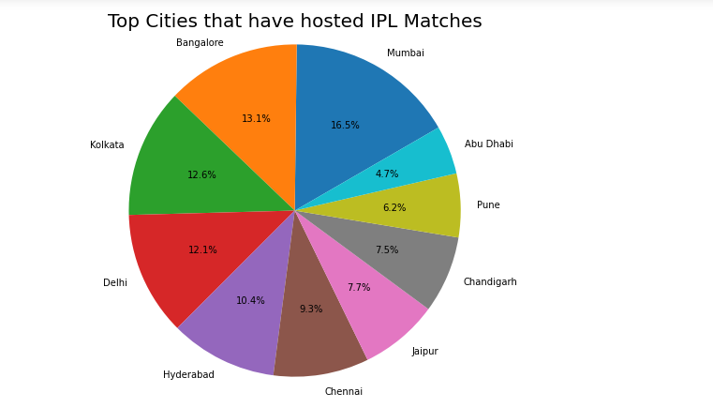
Top 10 cities, hosted most IPL matches

Slide 19
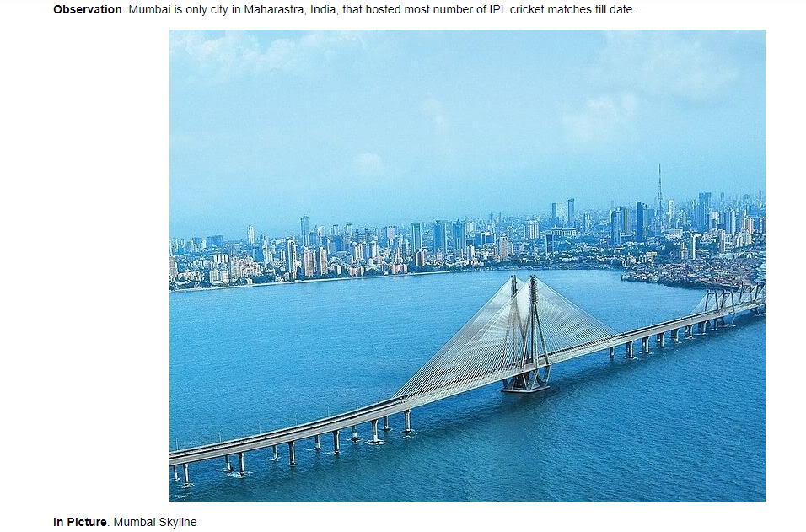

Slide 20
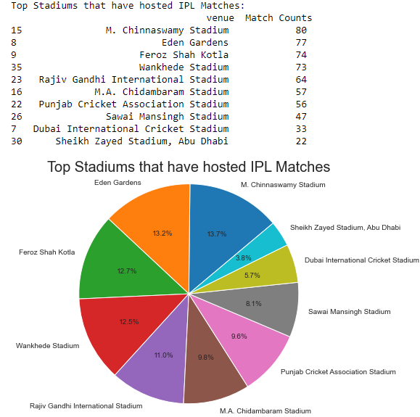
EDA - Top Stadiums that have hosted IPL Matches

Slide 21
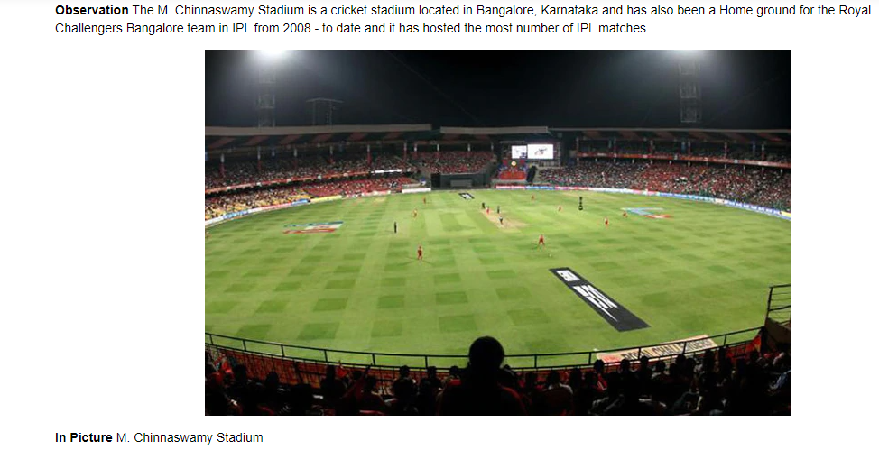

Slide 22
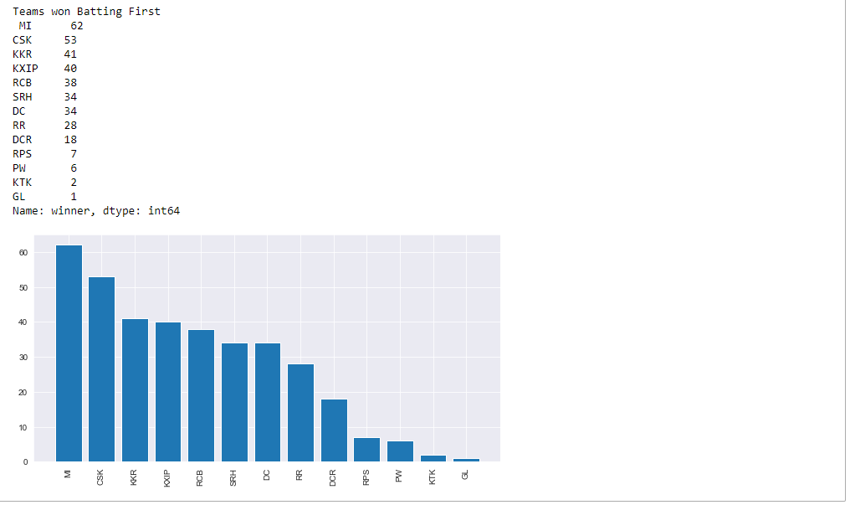
EDA - Matches won by teams batting 1st

Slide 23
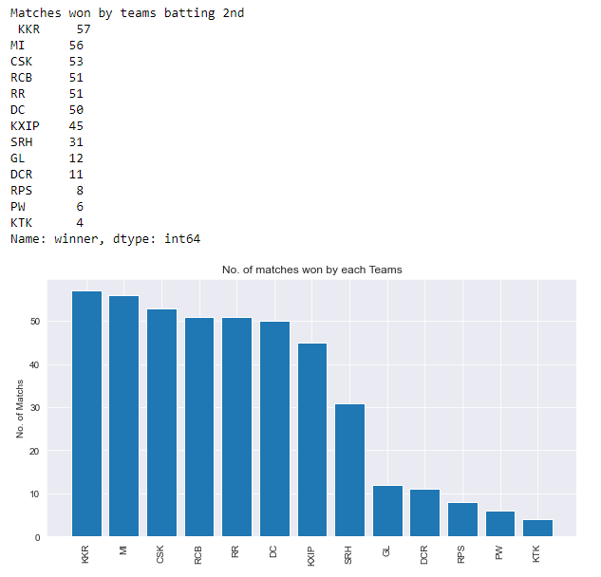
EDA - Matches won by teams batting 2nd

Slide 24
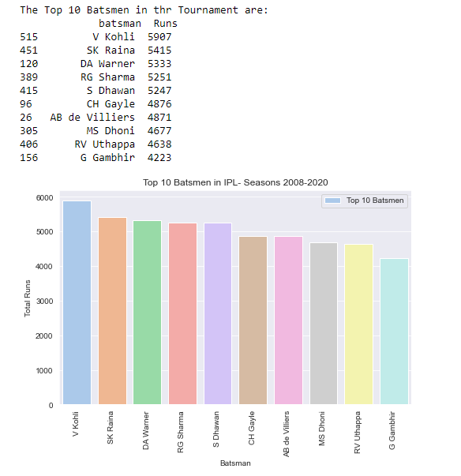
Top 10 Batsman in the tournament – till date

Slide 25
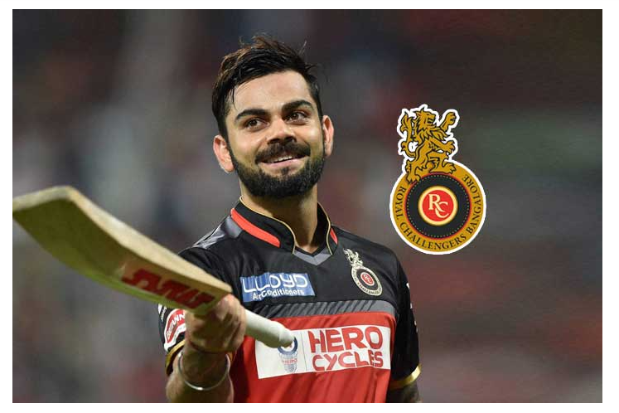
Top Batsman in the IPL– Virat Kohli

Slide 26
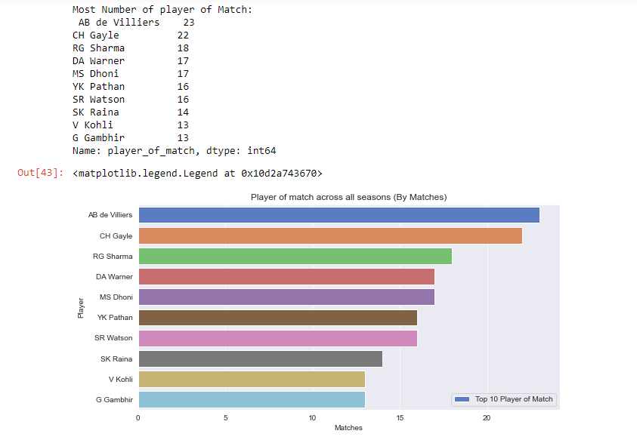
Most number of Player Of the Match in the tournament – till date

Slide 27
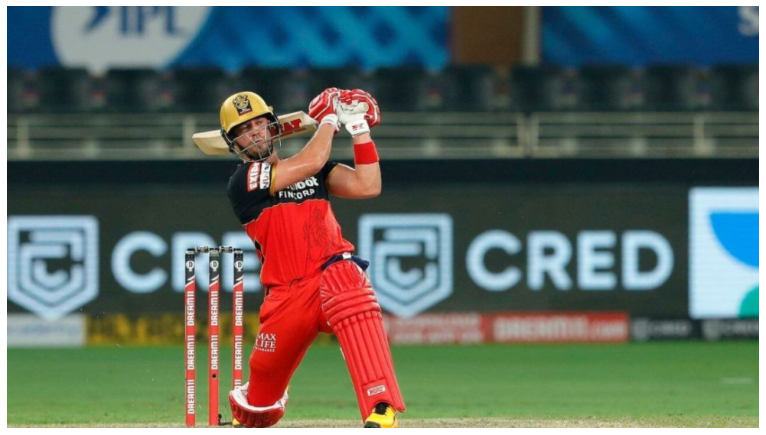
Most Player Of Match award – AB D’villiers

Slide 28
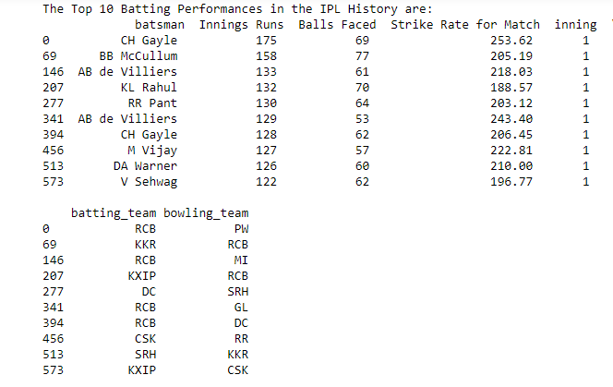
Top 10 high scoring Batsman in a match.

Slide 29
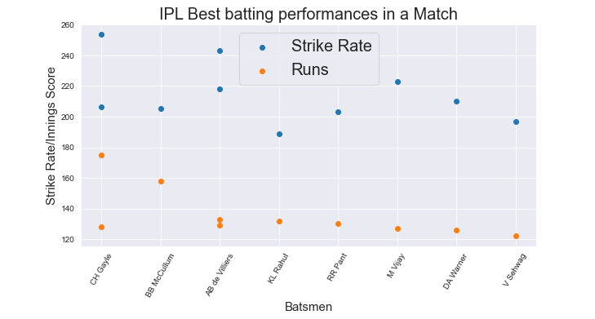
IPL Best Batting Performances in a Match

Slide 30
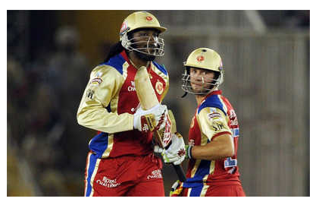
IPL Best Batting Performances in a Match

Slide 31
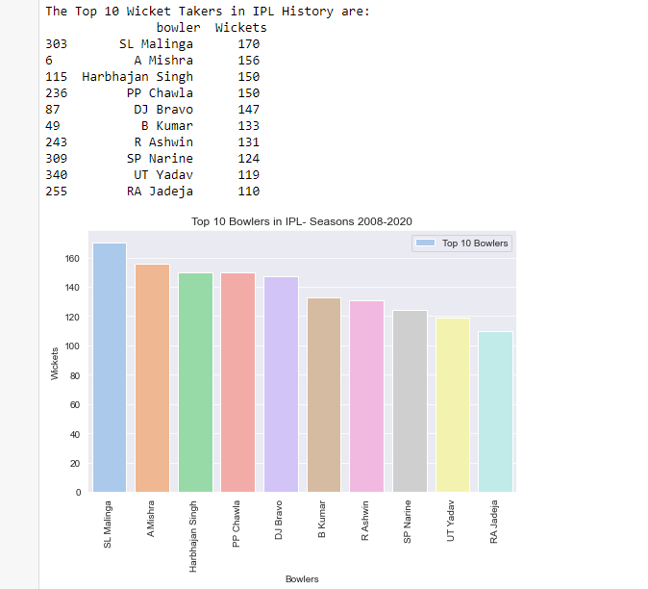
Top 10 highest Wicket Takers in the IPL

Slide 32
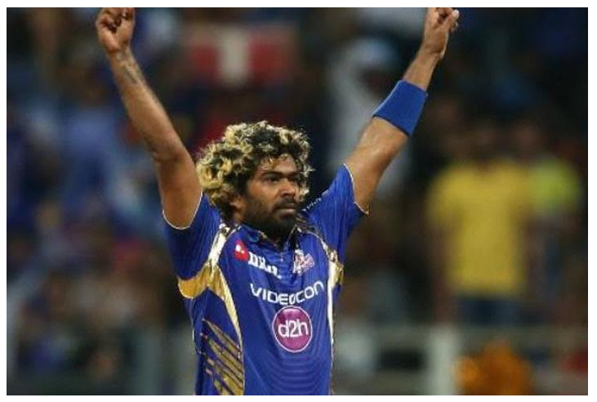
Highest Wicket Taker in IPL – Lasith Malinga

Slide 33
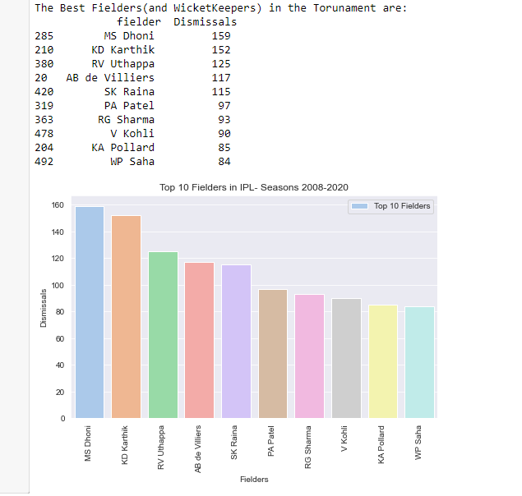
Top 10 Fielders/Wicket Keepers in IPL

Slide 34
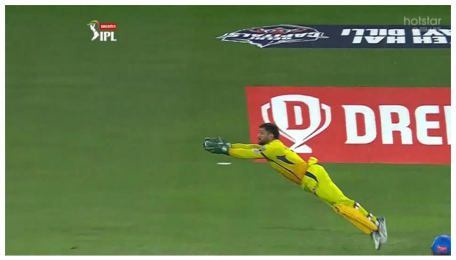
Top Fielder/Wicket Keeper in IPL – MS Dhoni

Slide 35
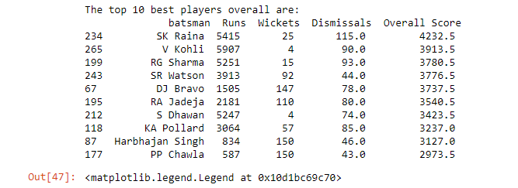
Top 10 All-Rounders in IPL

Slide 36
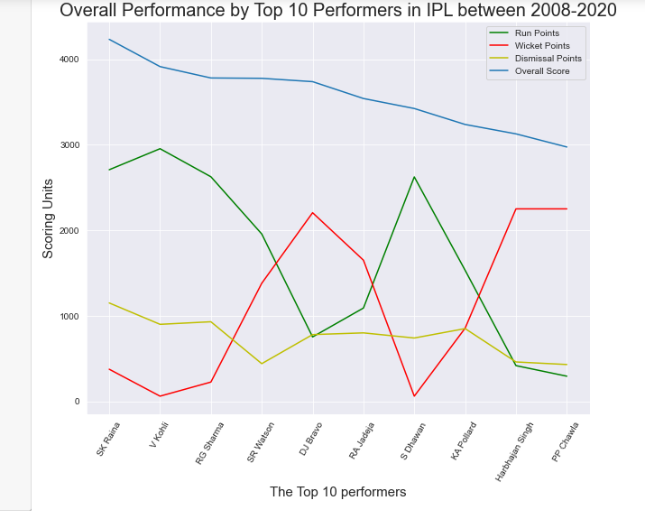
Top 10 All-Rounders in IPL

Slide 37
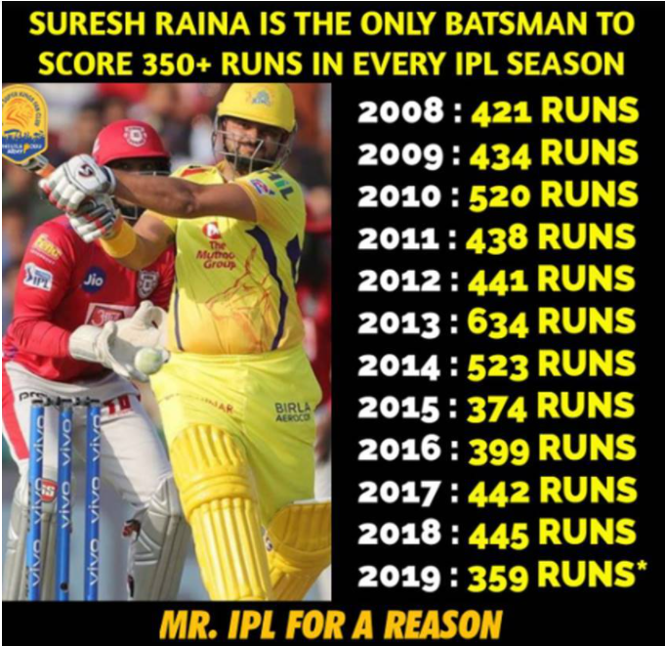

Slide 38
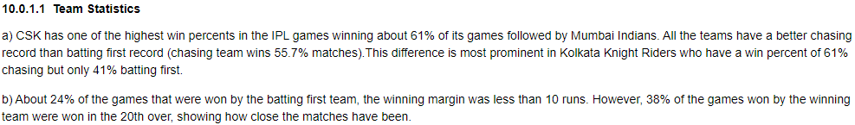
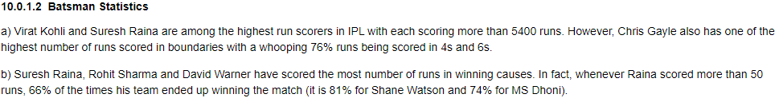
Summarization

Slide 39
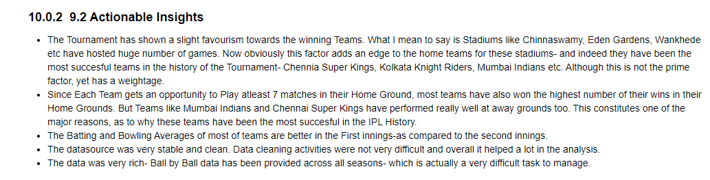
Actionable Insights

Slide 40


